Slide 1
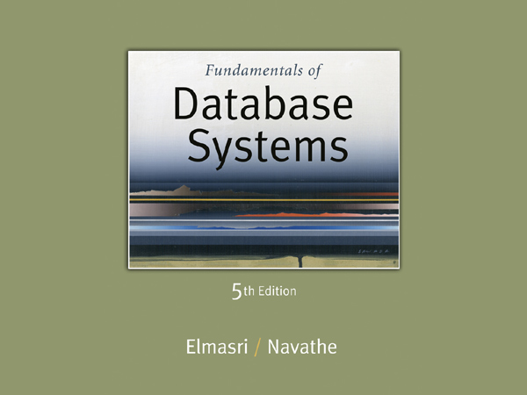

Slide 2
Chapter 10
Functional Dependencies and Normalization for Relational Databases

Slide 3
Chapter Outline
1 Informal Design Guidelines for Relational Databases
1.1Semantics of the Relation Attributes
1.2 Redundant Information in Tuples and Update Anomalies
1.3 Null Values in Tuples
1.4 Spurious Tuples
2 Functional Dependencies (FDs)
2.1 Definition of FD
2.2 Inference Rules for FDs
2.3 Equivalence of Sets of FDs
2.4 Minimal Sets of FDs

Slide 4
Chapter Outline
3 Normal Forms Based on Primary Keys
3.1 Normalization of Relations
3.2 Practical Use of Normal Forms
3.3 Definitions of Keys and Attributes Participating in Keys
3.4 First Normal Form
3.5 Second Normal Form
3.6 Third Normal Form
4 General Normal Form Definitions (For Multiple Keys)
5 BCNF (Boyce-Codd Normal Form)

Slide 5
1 Informal Design Guidelines for Relational Databases (1)
What is relational database design?
The grouping of attributes to form "good" relation schemas
Two levels of relation schemas
The logical "user view" level
The storage "base relation" level
Design is concerned mainly with base relations
What are the criteria for "good" base relations?

Slide 6
Informal Design Guidelines for Relational Databases (2)
We first discuss informal guidelines for good relational design
Then we discuss formal concepts of functional dependencies and normal forms
- 1NF (First Normal Form)
- 2NF (Second Normal Form)
- 3NF (Third Normal Form)
- BCNF (Boyce-Codd Normal Form)
Additional types of dependencies, further normal forms, relational design algorithms by synthesis are discussed in Chapter 11

Slide 7
1.1 Semantics of the Relation Attributes
GUIDELINE 1: Informally, each tuple in a relation should represent one entity or relationship instance. (Applies to individual relations and their attributes).
Attributes of different entities (EMPLOYEEs, DEPARTMENTs, PROJECTs) should not be mixed in the same relation
Only foreign keys should be used to refer to other entities
Entity and relationship attributes should be kept apart as much as possible.
Bottom Line: Design a schema that can be explained easily relation by relation. The semantics of attributes should be easy to interpret.

Slide 8
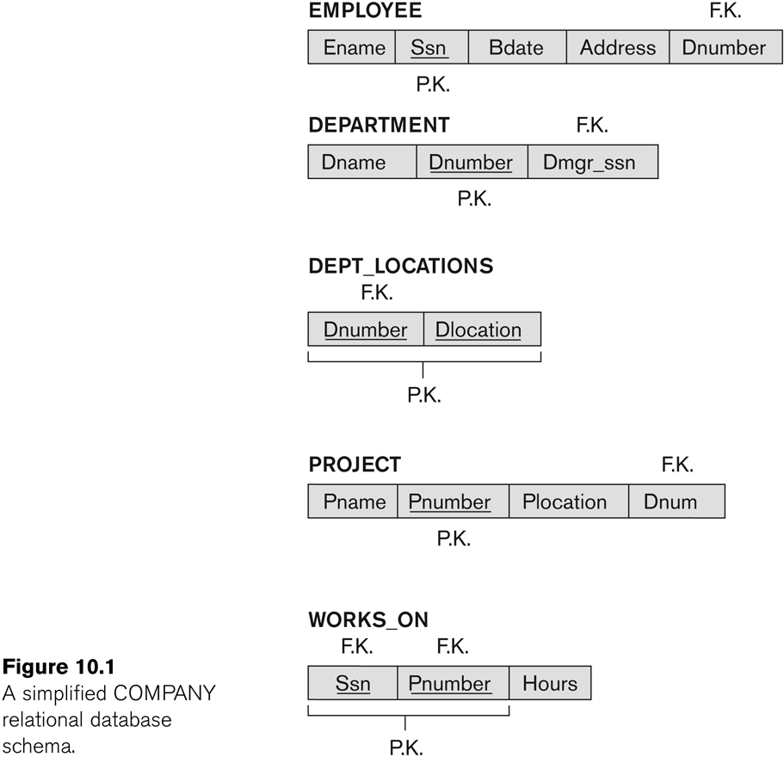
Figure 10.1 A simplified COMPANY relational database schema

Slide 9
1.2 Redundant Information in Tuples and Update Anomalies
Information is stored redundantly
Wastes storage
Causes problems with update anomalies
Insertion anomalies
Deletion anomalies
Modification anomalies

Slide 10
EXAMPLE OF AN UPDATE ANOMALY
Consider the relation:
EMP_PROJ(Emp#, Proj#, Ename, Pname, No_hours)
Update Anomaly:
Changing the name of project number P1 from “Billing” to “Customer-Accounting” may cause this update to be made for all 100 employees working on project P1.

Slide 11
EXAMPLE OF AN INSERT ANOMALY
Consider the relation:
EMP_PROJ(Emp#, Proj#, Ename, Pname, No_hours)
Insert Anomaly:
Cannot insert a project unless an employee is assigned to it.
Conversely
Cannot insert an employee unless an he/she is assigned to a project.

Slide 12
EXAMPLE OF AN DELETE ANOMALY
Consider the relation:
EMP_PROJ(Emp#, Proj#, Ename, Pname, No_hours)
Delete Anomaly:
When a project is deleted, it will result in deleting all the employees who work on that project.
Alternately, if an employee is the sole employee on a project, deleting that employee would result in deleting the corresponding project.

Slide 13
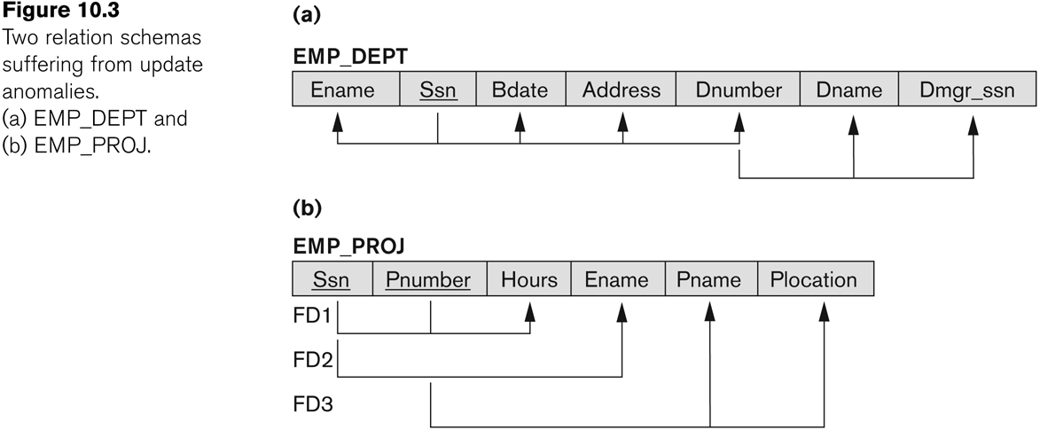
Figure 10.3 Two relation schemas suffering from update anomalies

Slide 14
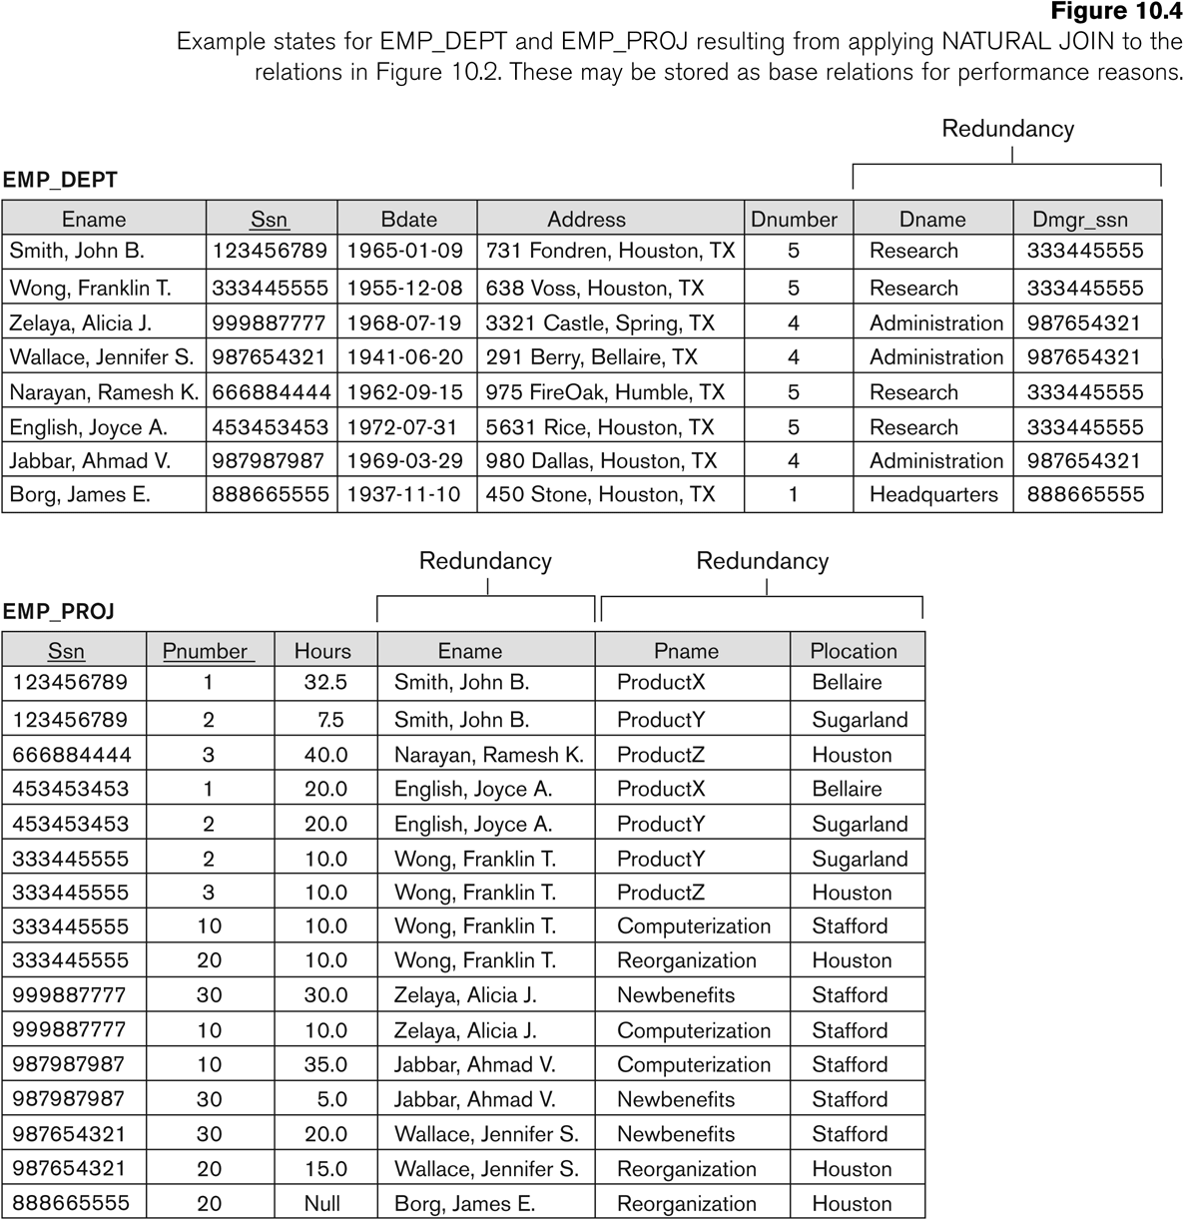
Figure 10.4 Example States for EMP_DEPT and EMP_PROJ

Slide 15
Guideline to Redundant Information in Tuples and Update Anomalies
GUIDELINE 2:
Design a schema that does not suffer from the insertion, deletion and update anomalies.
If there are any anomalies present, then note them so that applications can be made to take them into account.

Slide 16
1.3 Null Values in Tuples
GUIDELINE 3:
Relations should be designed such that their tuples will have as few NULL values as possible
Attributes that are NULL frequently could be placed in separate relations (with the primary key)
Reasons for nulls:
Attribute not applicable or invalid(Student Visa Status)
Attribute value unknown (may exist) (Emp DOB)
Value known to exist, but unavailable (Phone No)

Slide 17
2.1 Functional Dependencies (1)
Functional dependencies (FDs)
Are used to specify formal measures of the "goodness" of relational designs
And keys are used to define normal forms for relations
Are constraints that are derived from the meaning and interrelationships of the data attributes
A set of attributes X functionally determines a set of attributes Y if the value of X determines a unique value for Y

Slide 18
Functional Dependencies (2)
Written as X -> Y; can be displayed graphically on a relation schema

Slide 19
Examples of FD constraints (1)
Social security number determines employee name
SSN -> ENAME
Project number determines project name and location
PNUMBER -> {PNAME, PLOCATION}
Employee ssn and project number determines the hours per week that the employee works on the project
{SSN, PNUMBER} -> HOURS

Slide 20
Examples of FD constraints (2)
An FD is a property of the attributes in the schema R
The constraint must hold on every relation instance r(R)
If K is a key of R, then K functionally determines all attributes in R
(since we never have two distinct tuples with t1[K]=t2[K])

Slide 21
2.2 Inference Rules for FDs (1)
Given a set of FDs F, we can infer additional FDs that hold whenever the FDs in F hold
Armstrong's inference rules:
IR1. (Reflexive) If Y subset-of X, then X -> Y
IR2. (Augmentation) If X -> Y, then XZ -> YZ
(Notation: XZ stands for X U Z)
IR3. (Transitive) If X -> Y and Y -> Z, then X -> Z
IR1, IR2, IR3 form a sound and complete set of inference rules
These rules hold and all other rules that hold can be deduced from these

Slide 22
Inference Rules for FDs (2)
Some additional inference rules that are useful:
Decomposition: If X -> YZ, then X -> Y and X -> Z
Union: If X -> Y and X -> Z, then X -> YZ
Psuedotransitivity: If X -> Y and WY -> Z, then WX -> Z
The last three inference rules, as well as any other inference rules, can be deduced from IR1, IR2, and IR3 (completeness property)

Slide 23
Inference Rules for FDs (3)
Closure of a set F of FDs is the set F⁺ of all FDs that can be inferred from F
Closure of a set of attributes X with respect to F is the set X⁺ of all attributes that are functionally determined by X
X⁺ can be calculated by repeatedly applying IR1, IR2, IR3 using the FDs in F

Slide 24
Example
Let we specify the following set F of functional dependencies that should hold on EMP_PROJ:
F = {SSN->ENAME,
PNUMBER->{PNAME, PLOCATION},
{SSN, PNUMBER}->HOURS}

Slide 25
Example (Cont..)
we calculate the following closure sets with respect to F:
{ SSN }⁺ = { SSN, ENAME }
{ PNUMBER }⁺ = { PNUMBER, PNAME, PLOCATION }
{ SSN, PNUMBER }⁺ = { SSN, PNUMBER, HOURS }

Slide 26
Example (Cont..)
Functional Dependency set
{ STUD_NO->STUD_NAME,
STUD_NO->STUD_PHONE,
STUD_NO->STUD_STATE,
STUD_NO->STUD_COUNTRY,
STUD_NO -> STUD_AGE,
STUD_STATE->STUD_COUNTRY }
Closure Set
(STUD_NO)+ = {STUD_NO, STUD_NAME, STUD_PHONE, STUD_STATE, STUD_COUNTRY, STUD_AGE}
(STUD_STATE)+ = {STUD_STATE, STUD_COUNTRY}

Slide 27
Full Functional Dependency
Full Functional Dependency:
Only of relevance with composite determinants.
This is the situation when it is necessary to use all the attributes of the composite determinant to identify its object uniquely.
Full Functional Dependencies
order# line# qty price
A001 001 10 200
A002 001 20 400
A002 002 25 800
A004 001 15 300
(Order#, line#) → qty
(Order#, line#) → price

Slide 28
Partial Functional Dependency
Partial Functional Dependency:
This is the situation that exists if it is necessary to only use a subset of the attributes of the composite determinant to identify its object uniquely.
Example:
Full Functional Dependencies
student# unit# room grade
9900100 A01 TH224 2
9900010 A01 TH224 14
9901011 A02 JS075 3
9900001 A01 TH224 16
(student#, unit#) → grade
Partial Functional Dependencies
unit# → room

Slide 29
Functional Dependency: Exercise
Abbreviations | Meaning
A | Employee no
B | Dept no
C | Manager’s emp no
D | Proj no directed by that manager
E | Dept name
F | Time allocated to specified proj

Slide 30
Functional Dependency: Exercise
Abbreviations | Meaning
A → BC | Employee no → Deptno, Manager’s emp no
B → E | Dept no → Dept name
CD → EF | Manager’s emp no, Proj no directed by that manager → Dept name, Time allocated to specified proj
We now show that FD (AD → F) holds in R

Slide 31
Solution
As A → BC (given)
So, A → C (1, decomposition)
And AD → CD (2, augmentation)
Similarly, as CD → EF (given)
So AD → EF (3 and 4, transitivity)
Hence, AD → F (5, decomposition)

Slide 32
2.3 Equivalence of Sets of FDs
Two sets of FDs F and G are equivalent if:
Every FD in F can be inferred from G, and
Every FD in G can be inferred from F
Hence, F and G are equivalent if F⁺ =G⁺
Definition (Covers):
F covers G if every FD in G can be inferred from F
(i.e., if G⁺ subset-of F⁺)
F and G are equivalent if F covers G and G covers F
There is an algorithm for checking equivalence of sets of FDs
See text book

Slide 33
Functional Dependency
Example:
staffNo job dept dname
SL10 Salesman 10 Sales
SA51 Manager 20 Accounts
DS40 Clerk 20 Accounts
OS45 Clerk 30 Operations

Slide 34
Functional Dependency
Example:
staffNo job dept dname
SL10 Salesman 10 Sales
SA51 Manager 20 Accounts
DS40 Clerk 20 Accounts
OS45 Clerk 30 Operations
Functional Dependencies
staffNo → job
staffNo → dept
staffNo → dname
dept → dname

Slide 35
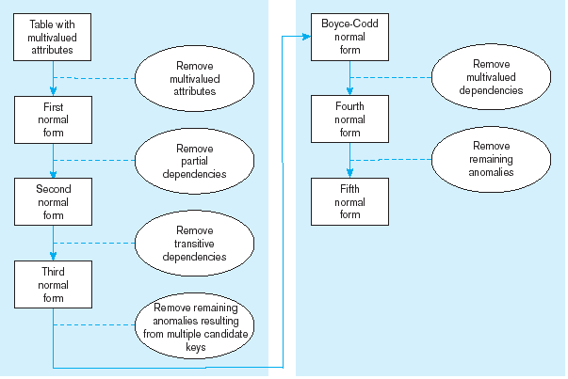
Steps in normalization

Slide 36
3 Normal Forms Based on Primary Keys
3.1 Normalization of Relations
3.2 Practical Use of Normal Forms
3.3 Definitions of Keys and Attributes Participating in Keys
3.4 First Normal Form
3.5 Second Normal Form
3.6 Third Normal Form

Slide 37
3.1 Normalization of Relations (1)
Normalization:
The process of decomposing unsatisfactory "bad" relations by breaking up their attributes into smaller relations
Normal form:
Condition using keys and FDs of a relation to certify whether a relational schema is in a particular normal form

Slide 38
Normalization of Relations (2)
2NF, 3NF, BCNF
based on keys and FDs of a relational schema
4NF
based on keys, multi-valued dependencies : MVDs; 5NF based on keys, join dependencies : JDs (Chapter 11)
Additional properties may be needed to ensure a good relational design (lossless join, dependency preservation; Chapter 11)

Slide 39
3.2 Practical Use of Normal Forms
Normalization is carried out in practice so that the resulting designs are of high quality and meet the desirable properties
The practical utility of these normal forms becomes questionable when the constraints on which they are based are hard to understand or to detect
The database designers need not normalize to the highest possible normal form
(usually up to 3NF, BCNF or 4NF)
Denormalization:
The process of storing the join of higher normal form relations as a base relation—which is in a lower normal form

Slide 40
3.2 First Normal Form
Disallows
composite attributes
multivalued attributes
nested relations; attributes whose values for an individual tuple are non-atomic

Slide 41
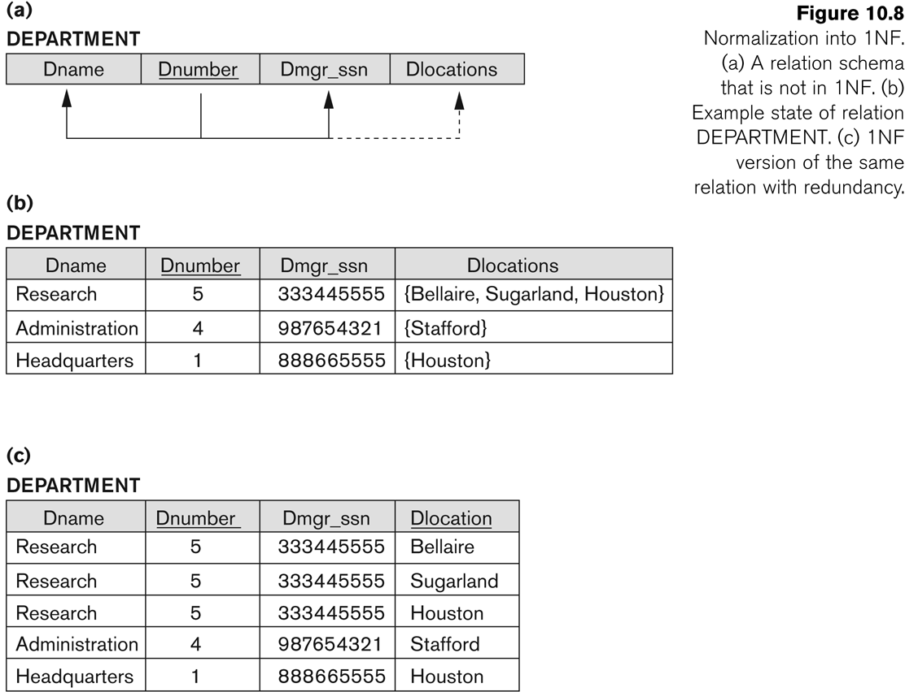
Figure 10.8 Normalization into 1NF

Slide 42
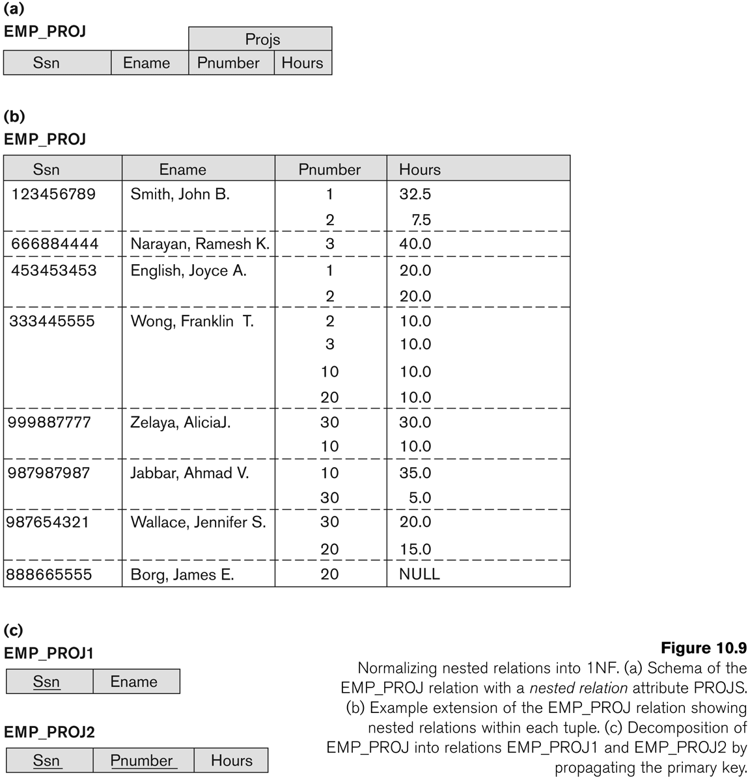
Figure 10.9 Normalization nested relations into 1NF

Slide 43
Another Example: Bringing a Relation to 1NF
Option 1: Make a determinant of the repeating group (or the multivalued attribute) a part of the primary key.
Composite Primary Key

Slide 44
Another Example: Bringing a Relation to 1NF
Option 2: Remove the entire repeating group from the relation.
Create another relation which would contain all the attributes of the repeating group, plus the primary key from the first relation.
In this new relation, the primary key from the original relation and the determinant of the repeating group will comprise a primary key.

Slide 45
Another Example: Bringing a Relation to 1NF

Slide 46
3.3 Second Normal Form (1)
Uses the concepts of FDs, primary key
Definitions
Prime attribute: An attribute that is member of the primary key K
Full functional dependency: a FD Y -> Z where removal of any attribute from Y means the FD does not hold any more
Examples:
{SSN, PNUMBER} -> HOURS is a full FD since neither SSN -> HOURS nor PNUMBER -> HOURS hold
{SSN, PNUMBER} -> ENAME is not a full FD (it is called a partial dependency ) since SSN -> ENAME also holds

Slide 47
Second Normal Form (2)
A relation schema R is in second normal form (2NF) if every non-prime attribute A in R is fully functionally dependent on the primary key
R can be decomposed into 2NF relations via the process of 2NF normalization

Slide 48
Bringing a Relation to 2NF
Composite Primary Key

Slide 49
Bringing a Relation to 2NF
Goal: Remove Partial Dependencies
Partial Dependencies
Composite Primary Key

Slide 50
Bringing a Relation to 2NF
Remove attributes that are dependent from the part but not the whole of the primary key from the original relation.
For each partial dependency, create a new relation, with the corresponding part of the primary key from the original as the primary key.

Slide 51
Bringing a Relation to 2NF

Slide 52
3.4 Third Normal Form (1)
Definition:
Transitive functional dependency: a FD X -> Z that can be derived from two FDs X -> Y and Y -> Z
Examples:
SSN -> DMGRSSN is a transitive FD
Since SSN -> DNUMBER and DNUMBER -> DMGRSSN hold
SSN -> ENAME is non-transitive
Since there is no set of attributes X where SSN -> X and X -> ENAME

Slide 53
Third Normal Form (2)
A relation schema R is in third normal form (3NF) if it is in 2NF and no non-prime attribute A in R is transitively dependent on the primary key
R can be decomposed into 3NF relations via the process of 3NF normalization
NOTE:
In X -> Y and Y -> Z, with X as the primary key, we consider this a problem only if Y is not a candidate key.
When Y is a candidate key, there is no problem with the transitive dependency .
E.g., Consider EMP (SSN, Emp#, Salary ).
Here, SSN -> Emp# -> Salary and Emp# is a candidate key.

Slide 54
Bringing a Relation to 3NF
Goal: Get rid of transitive dependencies.
Transitive Dependency

Slide 55
Bringing a Relation to 3NF
Remove the attributes, which are dependent on a non-key attribute, from the original relation.
For each transitive dependency,
create a new relation with the non-key attribute which is a determinant in the transitive dependency as a primary key,
and the dependent non-key attribute as a dependent.

Slide 56
Bringing a Relation to 3NF

Slide 57
Example
Primary Key (Supplier#, Part#)
S#
Status
City
P#
Qty
S1
20
London
P1
1600
S1
20
London
P2
2000
S2
10
Paris
P2
500
S3
20
London
P3
3000
Insert - cannot insert the fact that a supplier is located in a particular city until supplier supplies at least one part
Delete - delete the value P3, and we also lose the information that S3 is located in London
Update - S1 appears in the table more than once, and we must change all of them -- Possibility of producing an inconsistent result.

Slide 58
Example
By analyzing a given relation, we can identify some dependencies between its attributes.
In principle, we want to make attributes independent of each other as far as possible, so that updating one attribute will have no impact on the others.
Supplier#
City
Quantity
Part#
Status

Slide 59
2NF Example
FIRST {S#, STATUS, CITY, P#, QTY}
Primary key: {S#, P#}
{S#} -> {CITY}, {CITY} -> {STATUS}
Test of 2NF
{S#} -> {STATUS, CITY}: partial dependencies.
FIRST is in 1NF, but not in 2NF.
Decomposition:
SECOND {S#, STATUS, CITY}
SP {S# (FK: references SECOND), P#, QTY}

Slide 60
2NF-Solution to Problems
The solution is to replace the relation by two new relations (called One and Two)
One: Primary Key (Supplier#)
Two: Primary Key (Supplier#, Part#)
Supplier#
Status
City
Supplier#
Part#
Quantity
S1
20
London
S1
P1
1600
S2
10
Paris
S1
P2
2000
S3
20
London
S2
P2
500
S3
P3
3000
This revised structure overcomes all the problems sketched earlier, but:
Insert - cannot insert the fact that a particular city has a status until a supplier is actually located in that city.
Delete - delete the value S2, and we also lose the information that Paris has the status value 10.
Update - Status value 20 appears in the table more than once.

Slide 61
Third Normal Form (3NF)
A table is in 3NF if and only if
it is in 2NF and
every non-key attribute is non-transitively dependent on the primary key.
3NF prohibits transitive dependencies.
If A -> B and B -> C, C is transitively dependent on A.

Slide 62
3NF Example
SECOND {S#, STATUS, CITY}
Primary key: {S#}
{S#} -> {CITY}, {CITY} -> {STATUS}
Test of 3NF:
{S#} -> {CITY} -> {STATUS}: transitive dependency
SECOND is in 2NF, but not 3NF.
Decomposition:
CS {CITY, STATUS}
SC {S#, CITY (FK: references CS)}

Slide 63
Third Normal Form (3NF)
A relation is in 3NF if and only if it is 2NF and all non-key fields are mutually independent.
One: Primary Key (Supplier#)
Two: Primary Key (Supplier#, Part#)
Supplier#
Status
City
Supplier#
Part#
Quantity
S1
20
London
S1
P1
1600
S2
10
Paris
S1
P2
2000
S3
20
London
S2
P2
500
S3
P3
3000
Note: Relation Two is in 3NF (with only one non-key field), but relation One is not in 3NF because Status is dependent on City (both are non-key fields)

Slide 64
3NF - Converting 2NF into 3NF
We can now normalize relation One into two new relations (called three and four), which both are in 3NF.
Three: Primary Key (Supplier#)
Four: Primary Key (City)
Supplier#
City
S1
London
City
Status
London
20
S2
Paris
Paris
10
S3
London
Higher Normal Forms (e.g. 4NF and 5NF) do exist, but they are mainly of interest in academic societies rather than in the practical applications of database design.

Slide 65
Normal Forms Defined Informally
1st normal form
All attributes depend on the key
2nd normal form
All attributes depend on the whole key
3rd normal form
All attributes depend on nothing but the key

Slide 66
Stages of Normalisation
Unnormalised
(UDF)
Remove repeating groups
First normal form
(1NF)
Remove partial dependencies
Second normal form
(2NF)
Remove transitive dependencies
Third normal form
(3NF)

Slide 67
Example 2: University Database Table
Notes:
Big University Database Table:
- Table 7-1 except for omission of two columns (StdCity and OffTerm)

Slide 68
Example 2: University Database Table
StdSSN → StdCity, StdClass
OfferNo → OffTerm, OffYear, CourseNo, CrsDesc
CourseNo → CrsDesc
StdSSN, OfferNo → EnrGrade
Notes:
Big University Database Table:
- Table 7-1 except for omission of two columns (StdCity and OffTerm)

Slide 69
Problems
Anomalies:
- PK: combination of StdSSN and OfferNo
- Insert: cannot insert a new student without enrolling in an offering (OfferNo part of PK)
- Update: change a course description; change every enrollment of the course
- Delete: remove third row; lose information about course C3
Table has obvious redundancies
Easier to query: no joins
More difficult to change: can work around problems (dummy PK) but tedious to do

Slide 70
FD Diagrams and Lists
StdSSN → StdCity, StdClass
OfferNo → OffTerm, OffYear, CourseNo, CrsDesc
CourseNo → CrsDesc
StdSSN, OfferNo → EnrGrade
Notes:
FD diagram:
- 8.2 of textbook chapter 8
- See related FDs (same LHS) by line height
- Useful for small sets of FDs
- Unwieldy for large sets of FDs
FD list:
- Group by LHS
- Shortcut notation: X -> Y, Z is a shortcut for X -> Y and X -> Z
Compound LHS:
- Similar to a combined PK
- Compound LHS is not a shortcut (as is a compound RHS)
- Combination of StdSSN and OfferNo determine EnrGrade (not either column alone)
Minimality:
- LHS must be minimal
- Cannot remove columns from LHS without making the FD invalid
- Usually non minimal LHS is not a problem: important that LHS does not have
extraneous columns
- Properly known as full functional dependence: minimal LHS makes full functional dep.

Slide 71
Normalization
Process of removing unwanted redundancies
Apply normal forms
Identify FDs
Determine whether FDs meet normal form
Split the table to meet the normal form if there is a violation
Notes:
Normal form:
- Rule about allowable pattern of FDs (1NF through BCNF)
- Higher normal forms are not rules about FDs: more difficult to understand and use
- Most important part is to record FDs: CASE tool can perform normalization
- Check FDs to see if they violate the pattern permitted in the normal form
Split table
- Smaller tables do not violate the normal form
- Smaller tables should not lose information contained in the larger table
Difficulty:
- Normalization is easy to apply to small tables with simple dependency structures
- Use CASE tool for large databases and tables with complex dependency structures

Slide 72
1NF
No repeating groups: flat rows
Notes:
Big university database table is not normalized
- Not in 1NF
- S1 row has repeating values (O1 and O2)
- S2 row has repeating values (O3 and O2)
Convert to 1NF:
- Flatten rows
- Split each repeating group into a separate row
- Repeat the implied values in the new rows:
- S1 JUN for row two with O2 2000 3.3 C2 VB
- S2 JUN for row four with O2 2000 3.4 C2 VB

Slide 73
Combined Definition of 2NF/3NF
Key column: candidate key or part of candidate key
Analogy to the traditional justice oath
Every non key depends on a key, the whole key, and nothing but the key
Usually taught as separate definitions
Notes:
Candidate key:
- Unique
- Minimal: no extraneous columns without losing uniqueness property
- Can have multiple candidate keys per table
Key column:
- A candidate key by itself
- Part of a combined CK
- Nonkey: a column that is not a key column
Combined definition:
- Analogy to traditional justice oath
- So help me: Ted Codd (father of relational databases)
- Usually taught as separate definitions for simplicity

Slide 74
2NF
Every nonkey column depends on a whole key, not part of a key
Violations
Part of key → nonkey
Violations only for combined keys
Notes:
First of combined 2NF/3NF definition: dependent on the whole key
Violation:
- Part of a key determines a non key
- If FDs for a table contain such an FD, split the table

Slide 75
2NF Example
Many violations for the big university database table
StdSSN → StdCity, StdClass
OfferNo → OffTerm, OffYear, CourseNo, CrsDesc
Splitting the table
UnivTable1 (StdSSN, StdCity, StdClass)
UnivTable2 (OfferNo, OffTerm, OffYear, CourseNo, CrsDesc)
Notes:
Violating FDs:
- All FDs violate except StdSSN, OfferNo -> EnrGrade
- StdSSN: part of a key (not the entire key)
- OfferNo: part of a key (not the entire key)
Splitting:
- Place each FD group in a separate table
- UnivTable1: StdSSN group
- UnivTable2: OfferNo group
- UnivTable3: StdSSN, OfferNo group
- No violations among new tables
- CourseNo -> CrsDesc (CourseNo is not part of a key)
- This FD violates 3NF, not 2NF
Splitting process:
- Recover original table with natural join
- Not lose any FDs: all FDs are derivable
- Books on normalization theory explain criteria: theory not important here

Slide 76
3NF
Every nonkey column depends only on a key not on non key columns
Violations: Nonkey → Nonkey
Alterative formulation
No transitive FDs
A → B, B → C then A → C
OfferNo → CourseNo, CourseNo → CrsDesc then OfferNo → CrsDesc
Notes:
Second part of combined 2NF/3NF definition: nothing but the key
Violation:
- Non key determines a non key
- If FDs for a table contain such an FD, split the table
Alternative formulation:
- No transitive FDs
- Law of transitivity: A < B, B < C then A < C
- Transitivity applies to FDs
- Not the preferred definition of 3NF: should not write down transitively derived FDs
- Simple synthesis procedure for BCNF

Slide 77
3NF Example
One violation in UnivTable2
CourseNo → CrsDesc
Splitting the table
UnivTable2-1 (OfferNo, OffTerm, OffYear, CourseNo)
UnivTable2-2 (CourseNo, CrsDesc)
Notes:
Violating FDs:
- CourseNo is non key
- Alternatively, OfferNo -> CrsDesc is a transitively derived FD
Splitting UnivTable2:
- Arrange by LHS
- UnivTable2-2: CourseNo is the PK

Slide 78
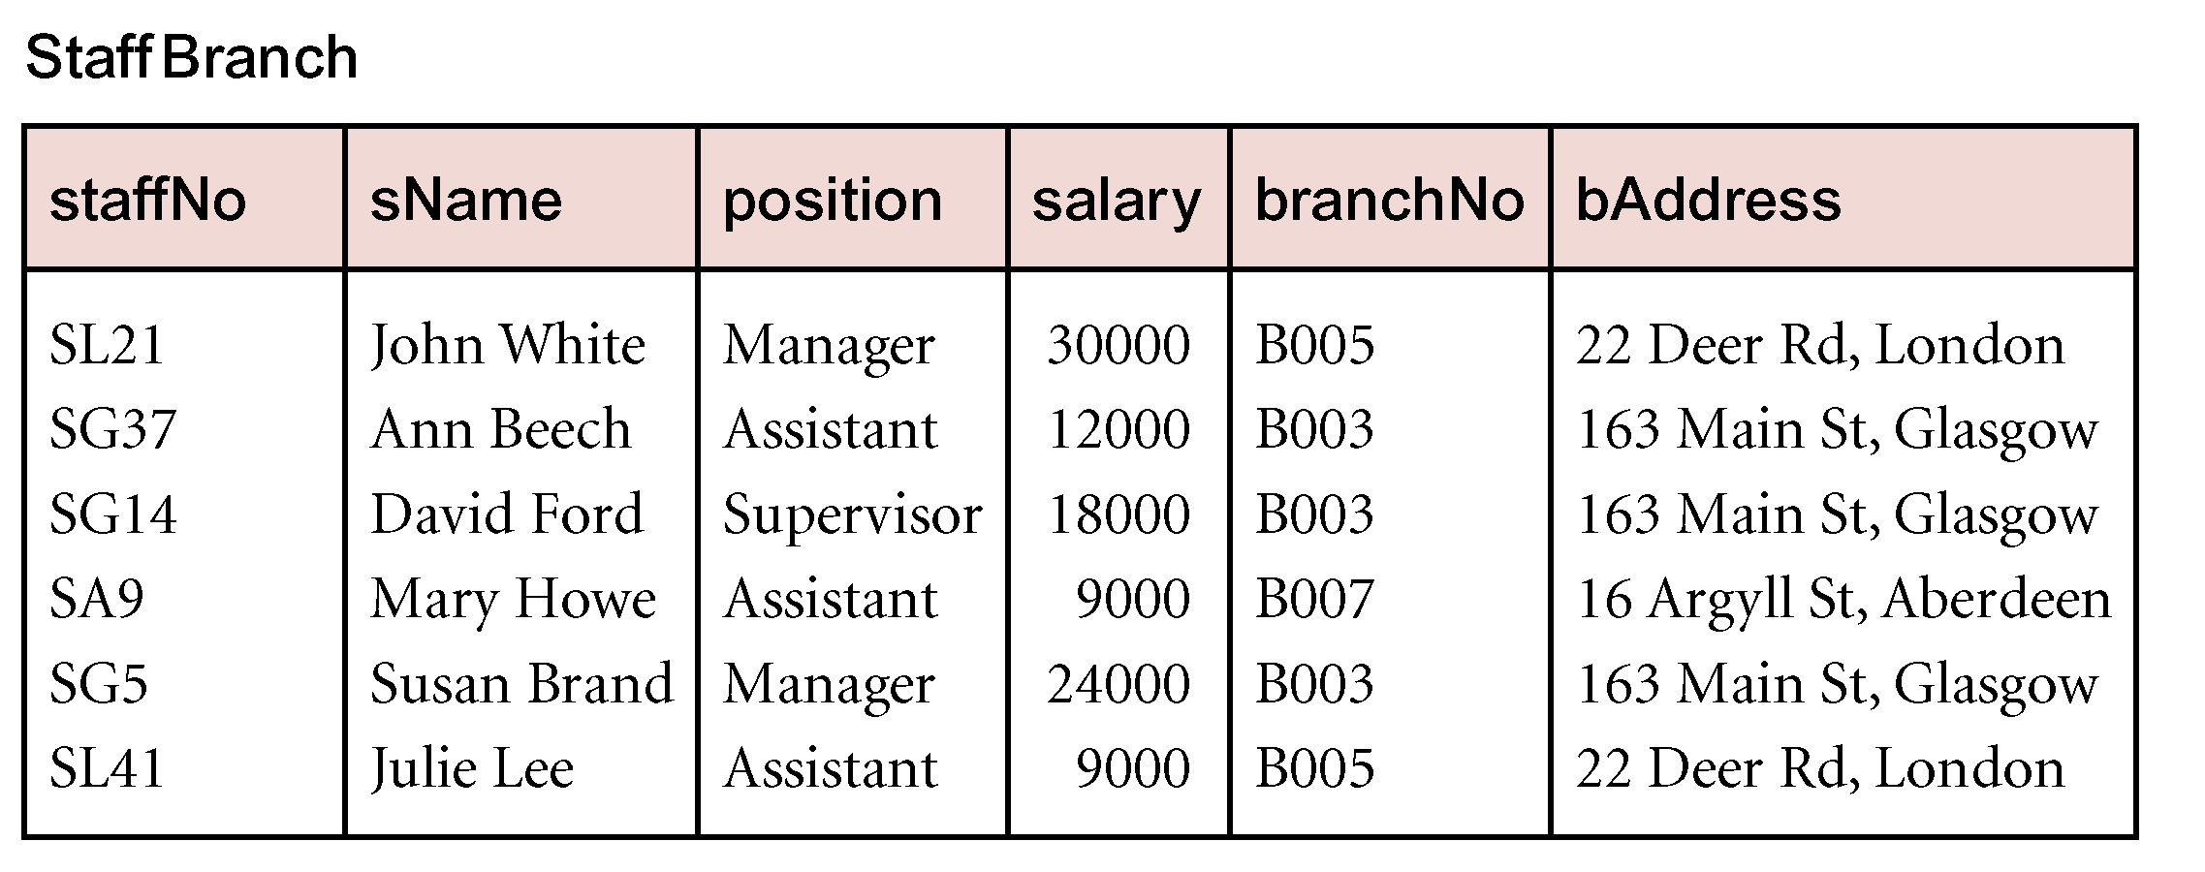
Example 2
Notes:
78

Slide 79
Unnormalised Normal Form (UNF)
ORDER (order-no, order-date, cust-no, cust-name, cust-add,
(prod-no, prod-desc, unit-price, ord-qty, line-total)*, order-total

Slide 80
First Normal Form (1NF)
Definition: A relation is in 1NF if, and only if, all its underlying attributes contain atomic values only.
Remove repeating groups into a new relation
A repeating group is shown by a pair of brackets within the relational schema.
ORDER (order-no, order-date, cust-no, cust-name, cust-add,
(prod-no, prod-desc, unit-price, ord-qty, line-total)*, order-total

Slide 81
Steps from UNF to 1NF:
Remove the outermost repeating group (and any nested repeated groups it may contain) and create a new relation to contain it.
Add to this relation a copy of the PK of the relation immediately enclosing it.
Name the new entity (appending the number 1 to indicate 1NF)
Determine the PK of the new entity
Repeat steps until no more repeating groups.

Slide 82
Example - UNF to 1NF
ORDER (order-no, order-date, cust-no, cust-name, cust-add,
(prod-no, prod-desc, unit-price, ord-qty, line-total)*, order-total
1. Remove the outermost repeating group (and any nested repeated groups it may contain) and create a new relation to contain it. (rename original to indicate 1NF)
ORDER-1 (order-no, order-date, cust-no, cust-name, cust-add, order-total
(prod-no, prod-desc, unit-price, ord-qty, line-total)
2. Add to this relation a copy of the PK of the relation immediately enclosing it.
ORDER-1 (order-no, order-date, cust-no, cust-name, cust-add, order-total
(order-no, prod-no, prod-desc, unit-price, ord-qty, line-total)
3. Name the new entity (appending the number 1 to indicate 1NF)
ORDER-LINE-1 (order-no, prod-no, prod-desc, unit-price, ord-qty, line-total)
4. Determine the PK of the new entity
ORDER-LINE-1 (order-no, prod-no, prod-desc, unit-price, ord-qty, line-total)

Slide 83
Second Normal Form (2NF)
Definition: A relation is in 2NF if, and only if, it is in 1NF and every non-key attribute is fully dependent on the primary key.
Remove partial functional dependencies into a new relation

Slide 84
Steps from 1NF to 2NF:
Remove the offending attributes that are only partially functionally dependent on the composite key, and place them in a new relation.
Add to this relation a copy of the attribute(s) which are the determinants of these offending attributes. These will automatically become the primary key of this new relation.
Name the new entity (appending the number 2 to indicate 2NF)
Rename the original entity (ending with a 2 to indicate 2NF)

Slide 85
Example - 1NF to 2NF
ORDER-LINE-1 (order-no, prod-no, prod-desc, unit-price, ord-qty, line-total)
1. Remove the offending attributes that are only partially functionally dependent on the composite key, and place them in a new relation.
ORDER-LINE-1 (order-no, prod-no, ord-qty, line-total)
(prod-desc, unit-price)
2. Add to this relation a copy of the attribute(s) which determines these offending attributes. These will automatically become the primary key of this new relation..
ORDER-LINE-1 (order-no, prod-no, ord-qty, line-total)
(prod-no, prod-desc, unit-price)
3. Name the new entity (appending the number 2 to indicate 2NF)
PRODUCT-2 (prod-no, prod-desc, unit-price)
4. Rename the original entity (ending with a 2 to indicate 2NF)
ORDER-LINE-2 (order-no, prod-no, ord-qty, line-total)

Slide 86
Third Normal Form (3NF)
Definition: A relation is in 3NF if, and only if, it is in 2NF and every non-key attribute is non-transitively dependent on the primary key.
Remove transitive dependencies into a new relation

Slide 87
Steps from 2NF to 3NF:
Remove the offending attributes that are transitively dependent on non-key attribute(s), and place them in a new relation.
Add to this relation a copy of the attribute(s) which are the determinants of these offending attributes. These will automatically become the primary key of this new relation.
Name the new entity (appending the number 3 to indicate 3NF)
Rename the original entity (ending with a 3 to indicate 3NF)

Slide 88
Example - 2NF to 3NF
ORDER-2 (order-no, order-date, cust-no, cust-name, cust-add, order-total
1. Remove the offending attributes that are transitively dependent on non-key attributes, and place them in a new relation.
ORDER-2 (order-no, order-date, cust-no, order-total
(cust-name, cust-add )
2. Add to this relation a copy of the attribute(s) which determines these offending attributes. These will automatically become the primary key of this new relation..
ORDER-2 (order-no, order-date, cust-no, order-total
(cust-no, cust-name, cust-add )
3. Name the new entity (appending the number 3 to indicate 3NF)
CUSTOMER-3 (cust-no, cust-name, cust-add )
4. Rename the original entity (ending with a 3 to indicate 3NF)
ORDER-3 (order-no, order-date, cust-no, order-total

Slide 89
Example - Relations in 3NF
ORDER-3 (order-no, order-date, cust-no, order-total
CUSTOMER-3 (cust-no, cust-name, cust-add )
PRODUCT-2 (prod-no, prod-desc, unit-price)
ORDER-LINE-2 (order-no, prod-no, ord-qty, line-total)
prod-no
order-no
PRODUCT
ORDER
shows
places
placed by
contains
belongs to
cust-no
order-no, prod-no
CUSTOMER
part of
ORDER-LINE

Slide 90
Reference
Chapter # 14
Fundamentals of database systems
7th Edition

